Slide 1
Storage and Compute: HDFS, MapReduce
Chris Nauroth
email: cnauroth@hortonworks.com
twitter: @cnauroth
October 14, 2015

Slide 2

About Me
Chris Nauroth
Member of Technical Staff, Hortonworks
Apache Hadoop committer, PMC member
Apache ZooKeeper committer
Apache Software Foundation member
Major contributor to HDFS ACLs, Windows compatibility, and operability improvements
Hadoop user since 2010
Prior employment experience deploying, maintaining and using Hadoop clusters
Notes:
First, a quick introduction. My name is Chris Nauroth. I’m a software engineer on the HDFS team at Hortonworks. I’m an Apache Hadoop committer and PMC member. I’m also an Apache Software Foundation member. Some of my major contributions include HDFS ACLs, Windows compatibility and various operability improvements.
Prior to Hortonworks, I worked for Disney and did an initial deployment of Hadoop there. As part of that job, I worked very closely with the systems engineering team responsible for maintaining those Hadoop clusters, so I tend to think back to that team and get excited about things I can do now as a software engineer to help make that team’s job easier.
I’m also here with Suresh Srinivas, one of the founders of Hortonworks, and a long-time Hadoop committer and PMC member. He has a lot of experience supporting some of the world’s largest clusters at Yahoo and elsewhere. Together with Suresh, we have experience supporting Hadoop clusters since 2008.

Slide 3
Agenda
History of Hadoop
HDFS: Hadoop Distributed File System
High-Level Architecture
Recent Features
Storage Architecture Evolution
MapReduce
High-Level Architecture
Computational Model
YARN
High-Level Architecture
Recent Features
Notes:
For today’s agenda, I’d like to start by sharing some analysis that we’ve done of support case trends. In that analysis, we’re going to see that some common patterns emerge, and that’s going to lead into a discussion of configuration best practices and software improvements.
In the second half of the talk, we’ll move into a discussion of key learnings and best practices around how recent HDFS features can help prevent problems or manage day-to-day maintenance.

Slide 4
History of Hadoop

Slide 5
History of Hadoop
Inspired by scalable storage and compute infrastructure developed at Google
The Google File System http://static.googleusercontent.com/media/research.google.com/en//archive/gfs-sosp2003.pdf
MapReduce: Simplified Data Processing on Large Clusters http://static.googleusercontent.com/media/research.google.com/en//archive/mapreduce-osdi04.pdf
Hadoop project created in 2005 as an offshoot of the Nutch search engine project
Yahoo was initial main user, followed by uptake by Facebook and others
Expanded to include a huge ecosystem of related projects
Now deployed widely in a variety of settings
Developed in open source in Apache Software Foundation
Contributors and committers come from diverse interests in industry and research.
Anyone can contribute!
Notes:
For today’s agenda, I’d like to start by sharing some analysis that we’ve done of support case trends. In that analysis, we’re going to see that some common patterns emerge, and that’s going to lead into a discussion of configuration best practices and software improvements.
In the second half of the talk, we’ll move into a discussion of key learnings and best practices around how recent HDFS features can help prevent problems or manage day-to-day maintenance.

Slide 6










Who’s Who in the Zoo
Data Storage and Resource Management
Data Access
HDFS (storage) works closely with MapReduce (data processing) to provide scalable, fault-tolerant, cost-efficient storage for big data.
Ver: 2.6.0
Pig (scripting) is a high-level language (Pig Latin) for data analysis programs, and infrastructure for evaluating these programs via map-reduce.
Ver: 0.14.0
YARN is the process resource manager and is designed to be co-deployed with HDFS such that there is a single cluster, providing the ability to move the computation resource to the data
Hive (SQL) Provides data warehouse infrastructure, enabling data summarization, ad-hoc query and analysis of large data sets. The query language, HiveQL (HQL), is similar to SQL.
Ver: 0.14.0
Data Engines
HCatalog (SQL) Table &storage management layer that provides users of Pig, MapReduce and Hive with a relational view of data in HDFS.
Map Reduce a programming model and an associated implementation for processing and generating large data sets with a parallel, distributed algorithm on a Hadoop cluster.
Ver: 2.6.0
Hbase (NoSQL) Non-relational database that provides random real-time access to data in very large tables. HBase is transactional and allows updates, inserts and deletes. HBase includes support for SQL through Phoenix.
Ver: 0.98.4
Tez (SQL) leverages the MapReduce paradigm to enable the execution complex Directed Acyclic Graphs (DAG) of tasks. Tez eliminates unnecessary tasks, synchronization barriers and I/O to HDFS, speeding up data processing.
Ver: 0.5.2
Accumulo (NoSQL) Based on Google's BigTable design, features a few novel improvements on the BigTable design in the form of cell-based access control
Ver: 1.6.1
Spark is an open-source data analytics cluster computing framework Spark provides primitives for in-memory cluster computing that allows user programs to load data into a cluster's memory and query it repeatedly, making it well suited to machine learning algorithms
Ver: 1.2.1
Phoenix a SQL skin over HBase delivered as a client-embedded JDBC driver targeting low latency queries over HBase data.
Ver: 4.2.0
Solr is an open source enterprise search platform from the Apache Lucene project. It includes full-text search, hit highlighting, faceted search, dynamic clustering, database integration, and rich document handling. And provides distributed search and index replication.

Slide 7









Who’s Who in the Zoo
Governance & Integration
Security
Knox (perimeter security) is a REST gateway for Hadoop providing network isolation, SSO, authentication, authorization and auditing functions.
Ver: 0.5.0
Falcon is a data governance engine that defines Oozie data pipelines, monitors those pipelines (in coordination with Ambari), and tracks those pipelines for dependencies and audits.
Ver: 0.6.0
Scoop is a tool that efficiently transfers bulk data between Hadoop and structured datastores such as relational databases.
Ver: 1.4.5
Ranger (security management) is a framework to monitor and manage security assets across a cluster. It provides central administration, monitoring and security hooks for Hadoop applications.
Ver: 0.4.0
Flume is a distributed service to collect, aggregate and move large amounts of streaming data into HDFS.
Ver: 1.5.2
Operations & Management
Zookeeper is a distributed configuration and synchronization service and a naming registry for distributed. Distributed applications use Zookeeper to store and mediate updates to
important configuration information.
Ver: 3.4.6
Storm (data streaming). Distributed real-time computation system for processing fast, large streams of data. Storm topologies can be written in any programming language.
Ver: 0.9.3
Oozie (job scheduling) Oozie enables administrators to build complex data transformations, enables greater control over long-running jobs and can schedule repetitions of those jobs.
Ver: 4.1.0.
Kafka (data streaming). A high-throughput distributed messaging system. Apache Kafka is publish-subscribe messaging rethought as a distributed commit log
Ver: 0.8.1.1
Ambari (cluster management) is an operational
framework to provision, manage and monitor Hadoop clusters. It includes a web interface for administrators to start/stop/test services and change configurations.
Ver: 1.7.0
Hue (Hadoop Use Experience) Web interface that supports Apache Hadoop and its ecosystem. Hue aggregates the most common Apache Hadoop components into a single interface and targets the user experience.
Ver: 2.6.1

Slide 8


Who’s Who in the Zoo
Libraries
File Formats
Mahout is a suite of machine learning libraries designed to be scalable and robust
Ver: 0.9.0
Avro A data serialization system. Provides, Rich data structures.A compact, fast, binary data format.
A container file, to store persistent data.
Ver: 1.7.4
Cascading is an application development platform for building Data applications on Apache Hadoop. Ver:
ORC The Optimized Row Columnar (ORC) file format, part of Hive, provides a highly efficient way to store Hive data. It was designed to overcome limitations of the other Hive file formats. Using ORC files improves performance when Hive is reading, writing, and processing data.
Ver: 0.14.0
Thrift
Thrift is a data serialization system that allows you to define data types and service interfaces in a simple definition file.
Ver: 0.13.0

Slide 9
HDFS High-Level Architecture

Slide 10
HDFS High-Level Architecture
NameNode
HDFS master service
Centralized storage of all file system metadata (inodes, paths, permissions, etc.)
Transaction Logging
Checkpointing
Rack Awareness
Health tracking of DataNodes
Deployed in redundant pairs for high availability
DataNode
Block level storage of file content
128 MB typical block size
Blocks replicated to multiple DataNodes for fault tolerance
Highly scalable: add/remove DataNodes to scale up/down
Client
Interacts with NameNode and DataNodes to provide read and write access to file system
Multiple options available: Java RPC client, WebHDFS REST API, LibHDFS for native code, NFS mountable

Slide 11
HDFS High-Level Architecture
File split into blocks of 128
Each block replicated 3x
High Availability
NameNode
NameNode
DataNode 1
DataNode 2
DataNode 3
DataNode 4
DataNode 5
DataNode 6
Block 1
Block 3
Block 4
Block 1
Block 4
Block 1
Block 2
Block 4
Block 2
Block 3
Block 2
Block 3

Slide 12
HDFS High Level Architecture
Fault Tolerance
End-to-end checksum verification of data on write and read
Background checksum verification of all stored replicas to detect bit rot
Corrupt replicas are declared invalid, and a new replica is created by copying another known good replica
Misreplication
Blocks may be under-replicated after failure of a DataNode
Blocks may be over-replicated after restoring a failed DataNode into service
Misreplicated blocks are detected automatically
Misreplication is corrected by copying another known good replica or deleting superfluous replicas
Balance
Over time, a cluster may develop hot spots: DataNodes storing a much greater proportion of blocks
Hotspots cause sub-optimal utilization of storage
Can reduce overall job throughput due to high contention on the same disks
HDFS favors placement of new replicas on under-utilized volumes
A balancer tool can be run to restore balance across a cluster by moving replicas of old files

Slide 13
HDFS Recent Features

Slide 14
HDFS Snapshots
HDFS Snapshots
A snapshot is a read-only point-in-time image of part of the file system
Performance: snapshot creation is instantaneous, regardless of data size or subtree depth
Reliability: snapshot creation is atomic
Scalability: snapshots do not create extra copies of data blocks
Useful for protecting against accidental deletion of data
Example: Daily Feeds hdfs dfs -ls /daily-feeds Found 5 items drwxr-xr-x - chris supergroup 0 2014-10-13 14:36 /daily-feeds/2014-10-13 drwxr-xr-x - chris supergroup 0 2014-10-13 14:36 /daily-feeds/2014-10-14 drwxr-xr-x - chris supergroup 0 2014-10-13 14:37 /daily-feeds/2014-10-15 drwxr-xr-x - chris supergroup 0 2014-10-13 14:37 /daily-feeds/2014-10-16 drwxr-xr-x - chris supergroup 0 2014-10-13 14:37 /daily-feeds/2014-10-17

Slide 15
HDFS Snapshots
Create a snapshot after each daily load hdfs dfsadmin -allowSnapshot /daily-feeds Allowing snaphot on /daily-feeds succeeded hdfs dfs -createSnapshot /daily-feeds snapshot-to-2014-10-17 Created snapshot /daily-feeds/.snapshot/snapshot-to-2014-10-17
User accidentally deletes data for 2014-10-16 hdfs dfs -ls /daily-feeds Found 4 items drwxr-xr-x - chris supergroup 0 2014-10-13 14:36 /daily-feeds/2014-10-13 drwxr-xr-x - chris supergroup 0 2014-10-13 14:36 /daily-feeds/2014-10-14 drwxr-xr-x - chris supergroup 0 2014-10-13 14:37 /daily-feeds/2014-10-15 drwxr-xr-x - chris supergroup 0 2014-10-13 14:37 /daily-feeds/2014-10-17

Slide 16
HDFS Snapshots
Snapshots to the rescue: the data is still in the snapshot hdfs dfs -ls /daily-feeds/.snapshot/snapshot-to-2014-10-17 Found 5 items drwxr-xr-x - chris supergroup 0 2014-10-13 14:36 /daily-feeds/.snapshot/snapshot-to-2014-10-17/2014-10-13 drwxr-xr-x - chris supergroup 0 2014-10-13 14:36 /daily-feeds/.snapshot/snapshot-to-2014-10-17/2014-10-14 drwxr-xr-x - chris supergroup 0 2014-10-13 14:37 /daily-feeds/.snapshot/snapshot-to-2014-10-17/2014-10-15 drwxr-xr-x - chris supergroup 0 2014-10-13 14:37 /daily-feeds/.snapshot/snapshot-to-2014-10-17/2014-10-16 drwxr-xr-x - chris supergroup 0 2014-10-13 14:37 /daily-feeds/.snapshot/snapshot-to-2014-10-17/2014-10-17
Restore data from 2014-10-16 hdfs dfs -cp /daily-feeds/.snapshot/snapshot-to-2014-10-17/2014-10-16 /daily-feeds
Notes:
By convention, snapshots can be referenced as a file system path under sub-directory “.snapshot”.

Slide 17
HDFS ACLs
Existing HDFS POSIX permissions good, but not flexible enough
Permission requirements may differ from the natural organizational hierarchy of users and groups.
HDFS ACLs augment the existing HDFS POSIX permissions model by implementing the POSIX ACL model.
An ACL (Access Control List) provides a way to set different permissions for specific named users or named groups, not only the file’s owner and file’s group.
Notes:
If you’ve used POSIX ACLs on a Linux file system, then you already know how it works in HDFS too.

Slide 18
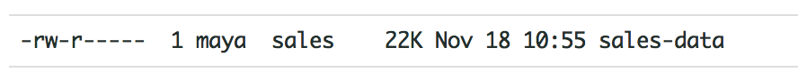
HDFS File Permissions Example
Authorization requirements:
In a sales department, they would like a single user Maya (Department Manager) to control all modifications to sales data
Other members of sales department need to view the data, but can’t modify it.
Everyone else in the company must not be allowed to view the data.
Can be implemented via the following:
Read perm for group sales
Group
Read/Write perm for user maya
User
File with sales data

Slide 19
HDFS ACLs
Problem
No longer feasible for Maya to control all modifications to the file
New Requirement: Maya, Diane and Clark are allowed to make modifications
New Requirement: New group called executives should be able to read the sales data
Current permissions model only allows permissions at 1 group and 1 user
Solution: HDFS ACLs
Now assign different permissions to different users and groups
HDFS Directory
Owner
… rwx
Group D
… rwx
Group
… rwx
Group F
… rwx
Others
… rwx
User Y
… rwx

Slide 20
HDFS ACLs
New Tools for ACL Management (setfacl, getfacl)
hdfs dfs -setfacl -m group:execs:r-- /sales-data
hdfs dfs -getfacl /sales-data # file: /sales-data # owner: maya # group: sales user::rw- group::r-- group:execs:r-- mask::r-- other::--
How do you know if a directory has ACLs set?
hdfs dfs -ls /sales-data Found 1 items -rw-r-----+ 3 maya sales 0 2014-03-04 16:31 /sales-data

Slide 21
HDFS ACLs Best Practices
Start with traditional HDFS permissions to implement most permission requirements.
Define a smaller number of ACLs to handle exceptional cases.
A file with an ACL incurs an additional cost in memory in the NameNode compared to a file that has only traditional permissions.

Slide 22
Reporting DataNode Volume Failures
Configuring dfs.datanode.failed.volumes.tolerated > 0 enables a DataNode to keep running after volume failures
DataNode is still running, but capacity is degraded
HDFS already provided a count of failed volumes for each DataNode, but no further details
Apache Hadoop 2.7.0 provides more information: failed path, estimated lost capacity and failure date/time
An administrator can use this information to prioritize cluster maintenance work

Slide 23
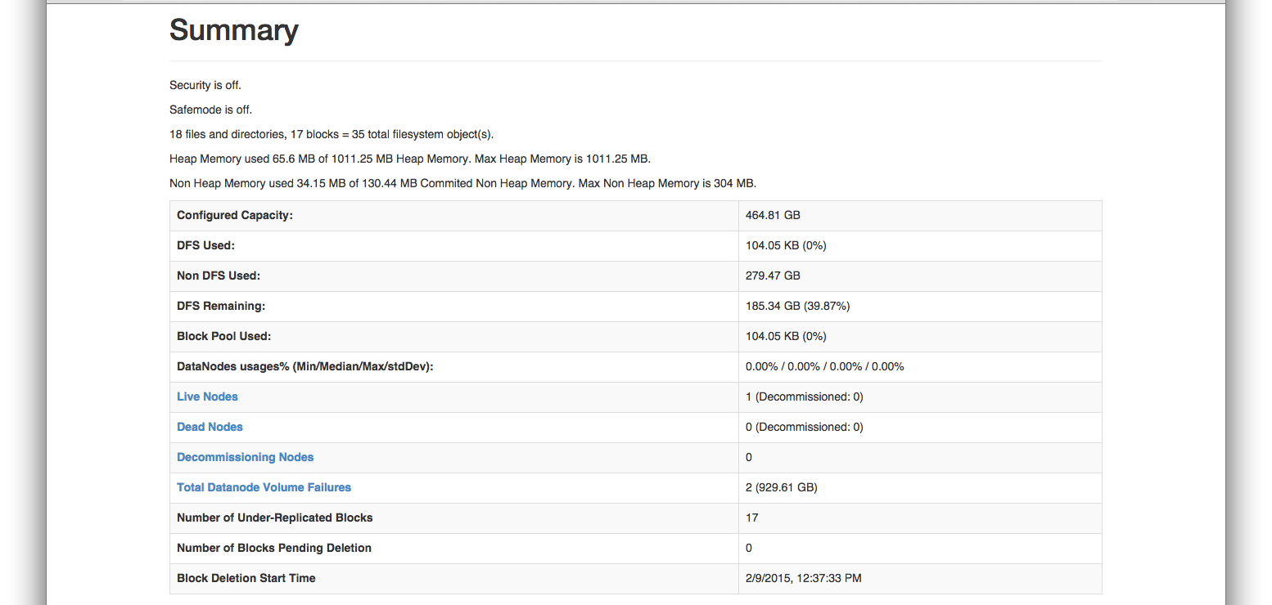
Reporting DataNode Volume Failures
New
Notes:
Here is a screenshot pointing out a change in the HDFS web UI: Total Datanode Volume Failures is a hyperlink. Clicking that jumps to…

Slide 24
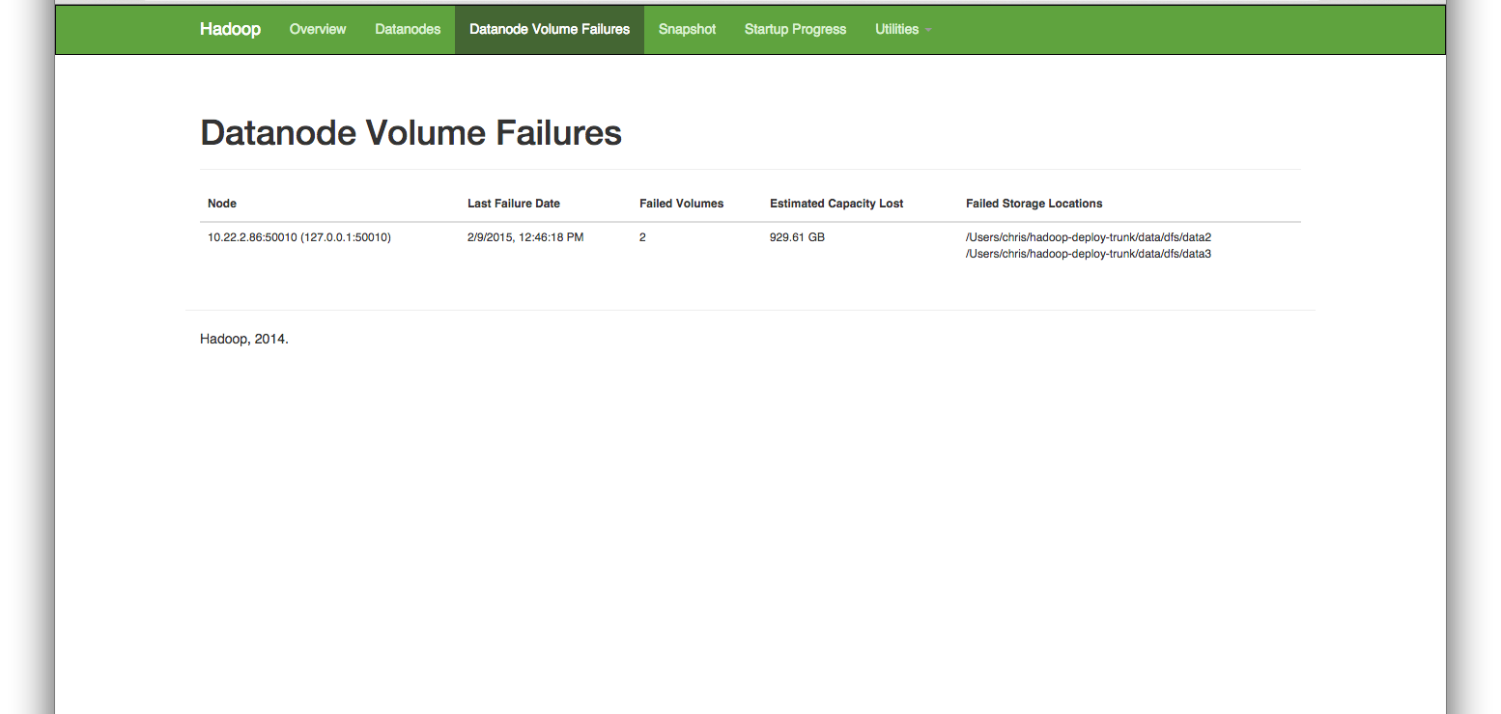
Reporting DataNode Volume Failures
Notes:
…this new screen listing the volume failures in detail. We can see the path of each failed storage location, and an estimate of the capacity that was lost. I think of this screen being used by a system engineer as a to-do list as part of regular cluster maintenance.

Slide 25
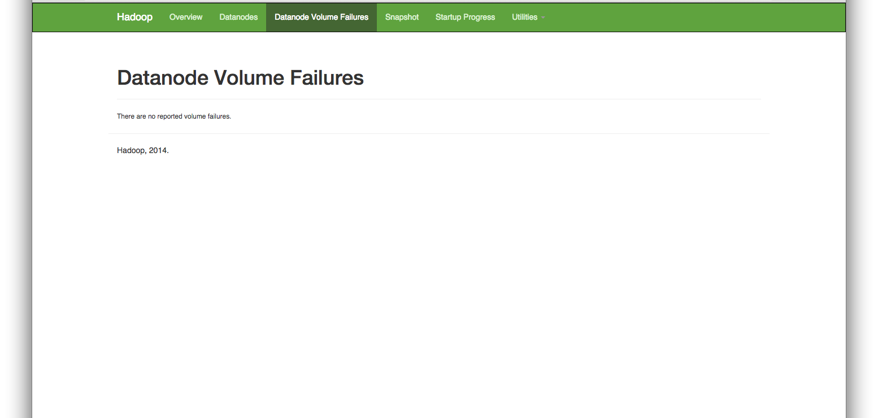
Reporting DataNode Volume Failures
Notes:
Here is what it looks like when there are no volume failures. I included this picture, because this is what we all want it to look like. Of course, it won’t always be that way.

Slide 26
Reporting DataNode Volume Failures
Everything in the web UI is sourced from standardized Hadoop metrics
Each DataNode publishes its own metrics
NameNode publishes aggregate information from every DataNode
Metrics accessible through JMX or the HTTP /jmx URI
Integrated in Ambari
Can be integrated into your preferred management tools and ops dashboards

Slide 27
HDFS Storage Architecture Evolution

Slide 28
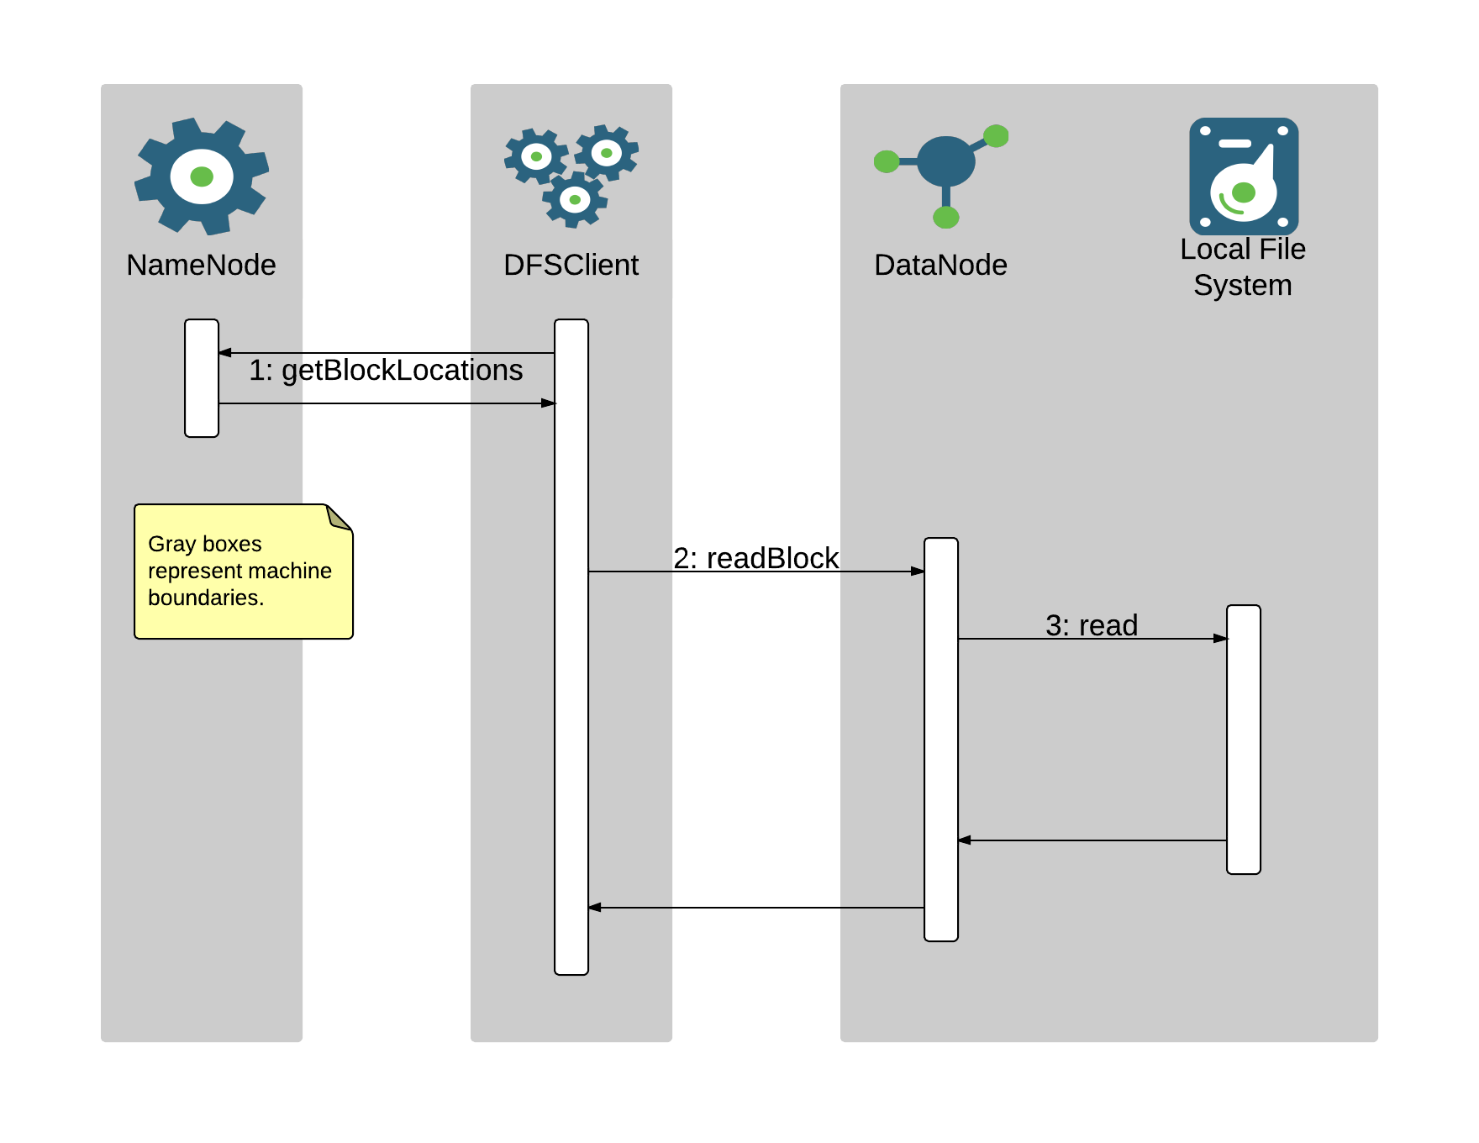
HDFS Reads

Slide 29
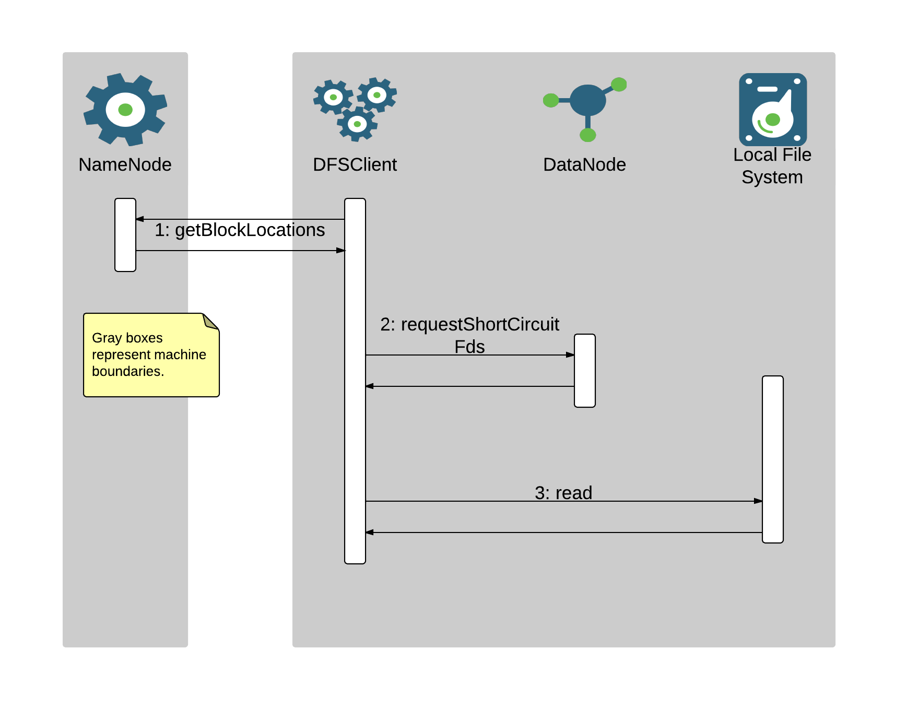
HDFS Short-Circuit Reads

Slide 30
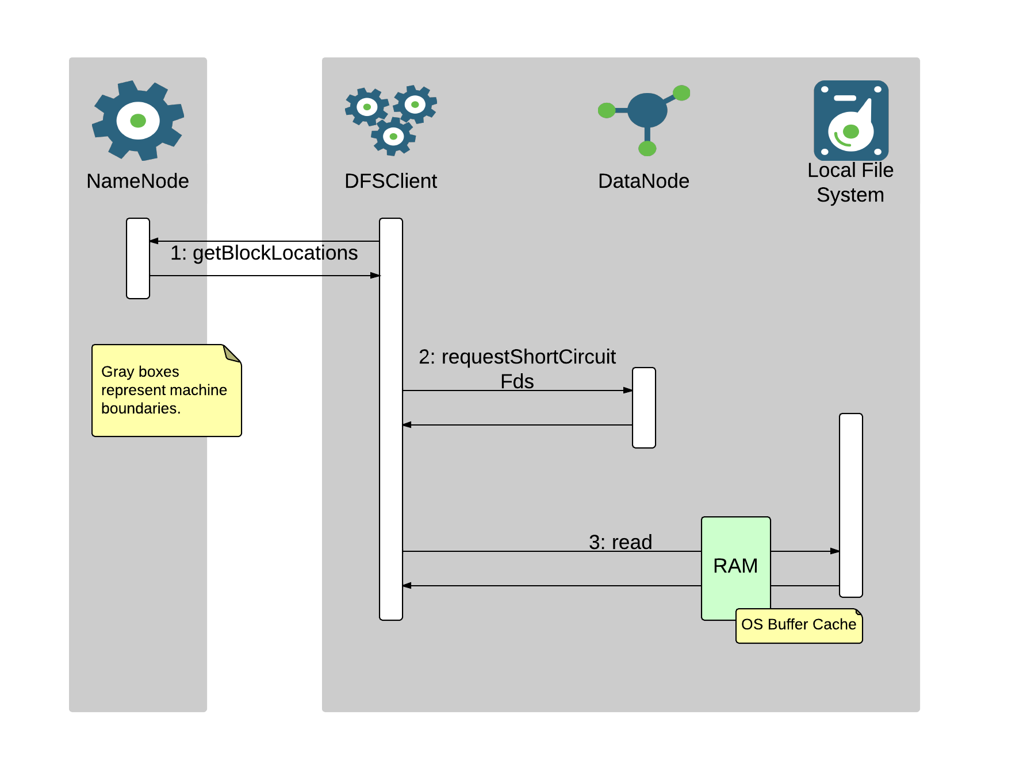
HDFS Short-Circuit Reads

Slide 31
Shortcomings of Existing RAM Utilization
Lack of Control
Kernel decides what to retain in cache and what to evict based on observations of access patterns.
Sub-optimal RAM Utilization
Tasks for multiple jobs are interleaved on the same node, and one task’s activity could trigger eviction of data that would have been valuable to retain in cache for the other task.

Slide 32
Centralized Cache Management
Provides users with explicit control of which HDFS file paths to keep resident in memory.
Allows clients to query location of cached block replicas, opening possibility for job scheduling improvements.
Utilizes off-heap memory, not subject to GC overhead or JVM tuning.

Slide 33
Using Centralized Cache Management
Pre-Requisites
Native Hadoop library required, currently supported on Linux only.
Set process ulimit for maximum locked memory.
Configure dfs.datanode.max.locked.memory in hdfs-site.xml, set to the amount of memory to dedicate towards caching.
New Concepts
Cache Pool
Contains and manages a group of cache directives.
Has Unix-style permissions.
Can constrain resource utilization by defining a maximum number of cached bytes or a maximum time to live.
Cache Directive
Specifies a file system path to cache.
Specifying a directory caches all files in that directory (not recursive).
Can specify number of replicas to cache and time to live.

Slide 34
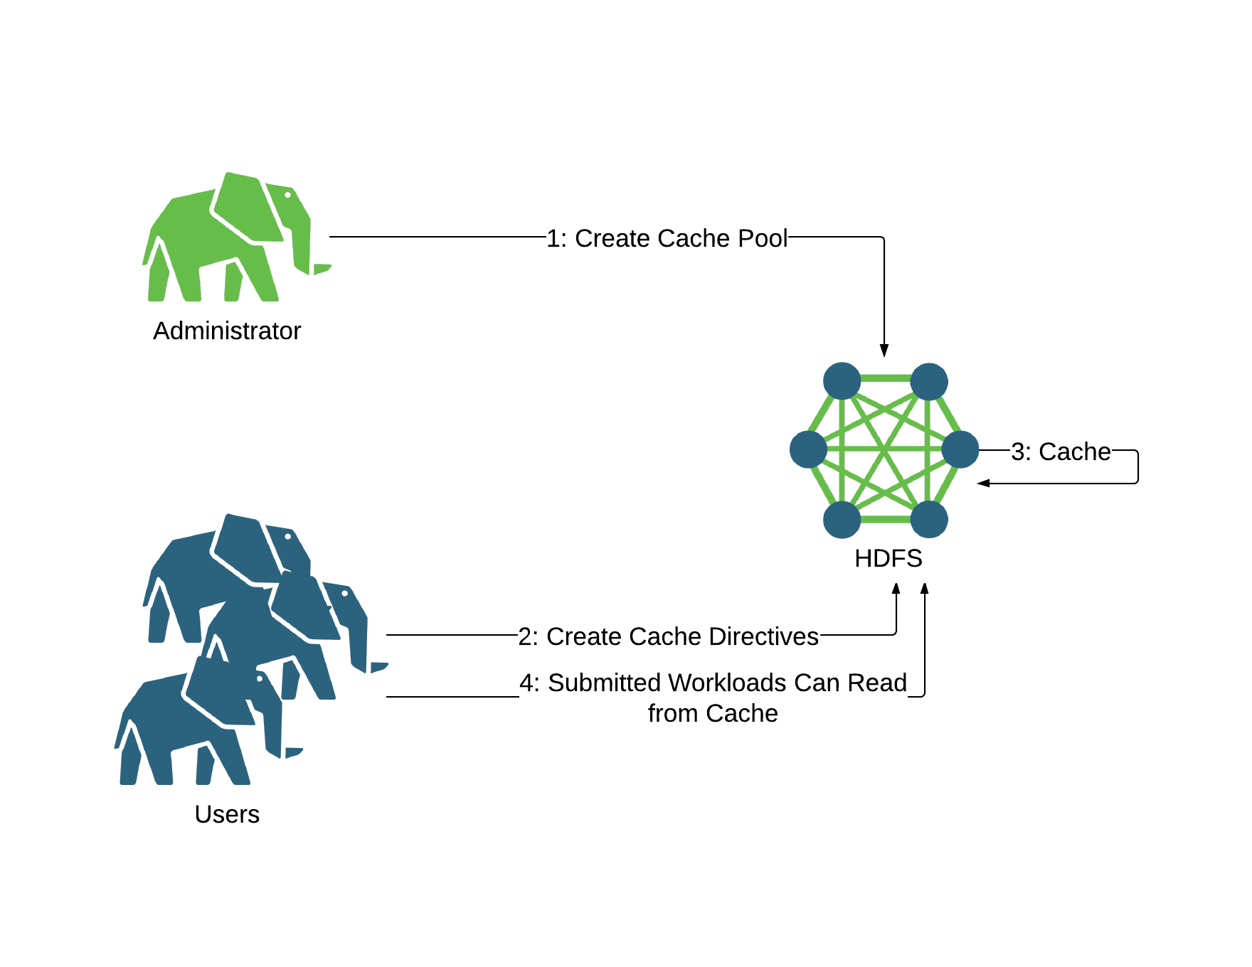
Using Centralized Cache Management

Slide 35
Using Centralized Cache Management
CLI: Adding a Cache Pool
> hdfs cacheadmin -addPool common-pool
Successfully added cache pool common-pool.
> hdfs cacheadmin -listPools
Found 1 result.
NAME OWNER GROUP MODE LIMIT MAXTTL
common-pool cnauroth cnauroth rwxr-xr-x unlimited never

Slide 36
Using Centralized Cache Management
CLI: Adding a Cache Directive
> hdfs cacheadmin -addDirective \
-path /hello-amsterdam \
-pool common-pool
Added cache directive 1
> hdfs cacheadmin -listDirectives
Found 1 entry
ID POOL REPL EXPIRY PATH
1 common-pool 1 never /hello-amsterdam

Slide 37
Using Centralized Cache Management
CLI: Removing a Cache Directive
> hdfs cacheadmin -removeDirective 1
Removed cached directive 1
> hdfs cacheadmin -removeDirectives \
-path /hello-amsterdam
Removed cached directive 1
Removed every cache directive with path /hello-amsterdam

Slide 38
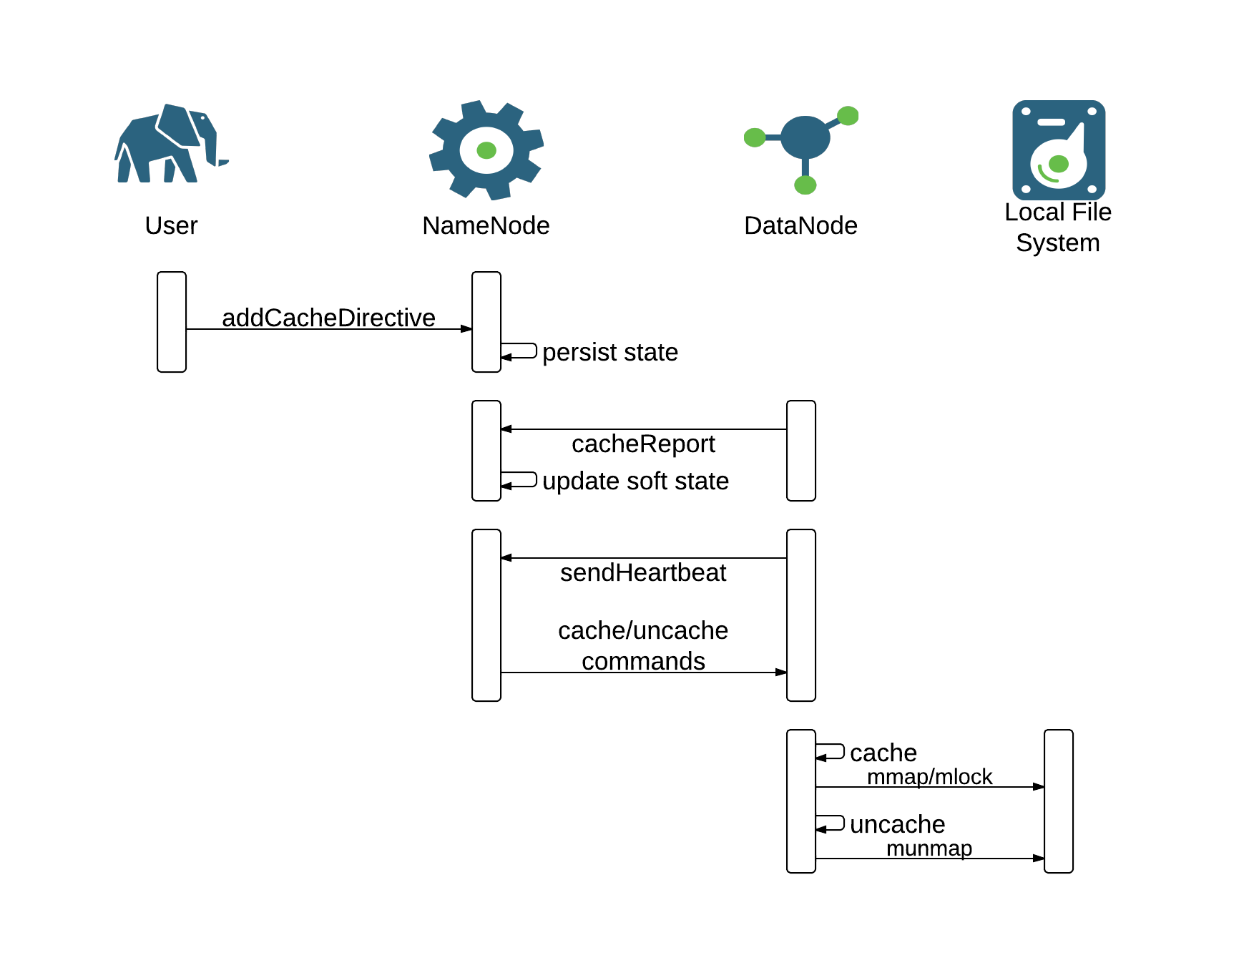
Centralized Cache Management Behind the Scenes

Slide 39
Centralized Cache Management Behind the Scenes
Block files are memory-mapped into the DataNode process.
> pmap `jps | grep DataNode | awk '{ print $1 }'` |
grep blk
00007f92e4b1f000 124928K r--s- /data/dfs/data/current/BP-1740238118-127.0.1.1-1395252171596/current/finalized/blk_1073741827
00007f92ecd21000 131072K r--s- /data/dfs/data/current/BP-1740238118-127.0.1.1-1395252171596/current/finalized/blk_1073741826

Slide 40
Centralized Cache Management Behind the Scenes
Pages of each block file are 100% resident in memory.
> vmtouch /data/dfs/data/current/BP-1740238118-127.0.1.1-1395252171596/current/finalized/blk_1073741826
Files: 1
Directories: 0
Resident Pages: 32768/32768 128M/128M 100%
Elapsed: 0.001198 seconds
> vmtouch /data/dfs/data/current/BP-1740238118-127.0.1.1-1395252171596/current/finalized/blk_1073741827
Files: 1
Directories: 0
Resident Pages: 31232/31232 122M/122M 100%
Elapsed: 0.00172 seconds

Slide 41
HDFS Zero-Copy Reads
Applications read straight from direct byte buffers, backed by the memory-mapped block file.
Eliminates overhead of intermediate copy of bytes to buffer in user space.
Applications must change code to use a new read API on DFSInputStream:
public ByteBuffer read(ByteBufferPool factory, int maxLength,
EnumSet<ReadOption> opts)

Slide 42
Heterogeneous Storage Goals
Extend HDFS to support a variety of Storage Media
Applications can choose their target storage
Use existing APIs wherever possible

Slide 43
Interesting Storage Media
 | Cost | Example Use case
Spinning Disk (HDD) | Low | High volume batch data
Solid State Disk (SSD) | 10x of HDD | HBase Tables
RAM | 100x of HDD | Hive Materialized Views
Your custom Media | ? | ?

Slide 44
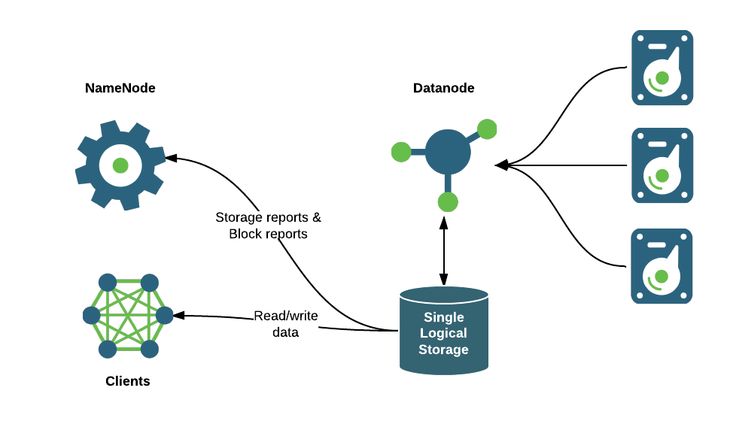
HDFS Storage Architecture - Before

Slide 45
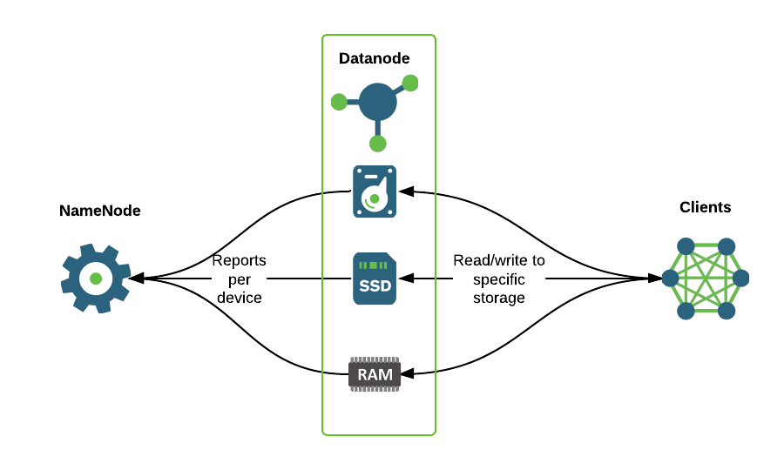
HDFS Storage Architecture - Now

Slide 46
Storage Preferences
Introduce Storage Type per Storage Medium
Storage Hint from application to HDFS
Specifies application’s preferred Storage Type
Advisory
Subject to available space/quotas
Fallback Storage is HDD
May be configurable in the future

Slide 47
Storage Preferences (continued)
Specify preference when creating a file
Write replicas directly to Storage Medium of choice
Change preference for an existing file
E.g. to migrate existing file replicas from HDD to SSD

Slide 48
Quota Management
Extend existing Quota Mechanisms
Administrators ensure fair distribution of limited resources

Slide 49
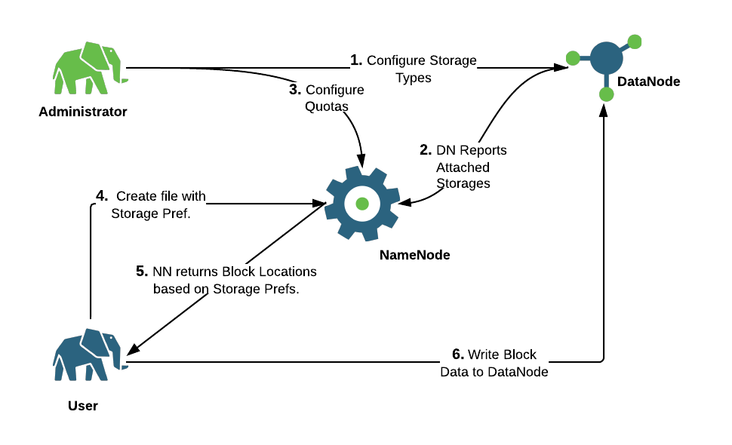
File Creation with Storage Types

Slide 50
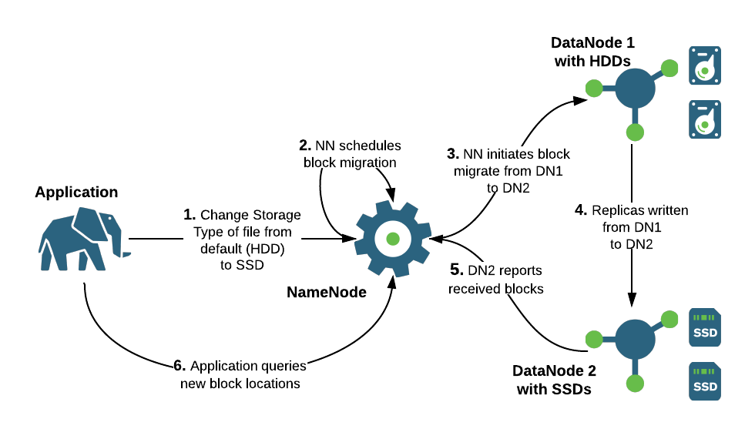
Move existing replicas to target Storage Type

Slide 51
Storage Policy Definition
Allows mapping between Dataset and Storage Type
Directory => Storage Type(s)
File => Storage Type(s)
Defines Creation Fallback Strategy
Strategy for when blocks are allocated and written
Where to write blocks when first Storage Type is out of space
Defines Replication Fallback Strategy
Strategy for when blocks are replicated
Where to store block replicas when first Storage Type is out of space

Slide 52
Storage Policies: Archival
Warm
1 replica on DISK, others on ARCHIVE
Cold
All replicas on ARCHIVE
Hot
All replicas on DISK
HDP Cluster
DISK
DISK
DISK
DISK
DISK
DISK
DISK
DISK
DISK
ARCHIVE
ARCHIVE
ARCHIVE
ARCHIVE
ARCHIVE
ARCHIVE
ARCHIVE
ARCHIVE
ARCHIVE

Slide 53
Storage Policies: Archival
Warm
1 replica on DISK, others on ARCHIVE
Cold
All replicas on ARCHIVE
DataSet A
DataSet B
HDP Cluster
DISK
DISK
DISK
DISK
DISK
DISK
DISK
DISK
DISK
ARCHIVE
ARCHIVE
ARCHIVE
ARCHIVE
ARCHIVE
ARCHIVE
ARCHIVE
ARCHIVE
ARCHIVE
A
B
A
B
A
B

Slide 54
Storage Policy: SSD
SSD
All replicas on SSD
DataSet A
HDP Cluster
SSD
DISK
DISK
SSD
DISK
DISK
SSD
DISK
DISK
SSD
DISK
DISK
SSD
DISK
DISK
SSD
DISK
DISK
A
A
A

Slide 55
Store Intermediate Data in Memory
For data writes:
Need low latency writes
Where data is re-generatable
Example Scenarios being explored:
Hive on Tez
Spark on Tez
Application Process
Write block to memory
Memory Tier
RAM_DISK
Lazy persist block to disk

Slide 56
MapReduce High-Level Architecture

Slide 57
MapReduce High-Level Architecture
JobTracker
MapReduce master service
Resource Management
Job Scheduling
Task Execution Monitoring
Job History
TaskTracker
Task Execution
Highly scalable: add/remove TaskTrackers to scale up/down
Client
Interacts with JobTracker for job submission and progress tracking

Slide 58
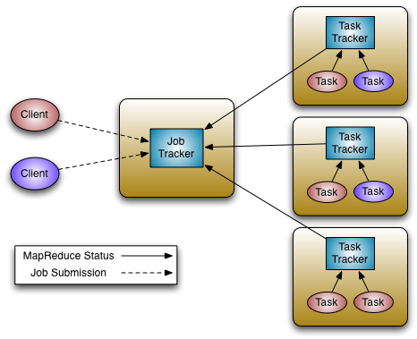
MapReduce High Level Architecture
JobTracker
Manages cluster resources and job scheduling
TaskTracker
Per-node agent
Manage tasks

Slide 59
MapReduce High-Level Architecture
Data Locality
MapReduce TaskTracker is co-located with HDFS DataNode
JobTracker attempts to schedule tasks to read blocks present on the same physical node to avoid extra cost of transferring over the network
Traditional data processing architectures pull the data to the computation. MapReduce pushes the computation to the data.
Fault Tolerance
Task attempt monitoring and retries
Speculative execution

Slide 60
MapReduce Computational Model

Slide 61
MapReduce Computational Model
Parallel, distributed algorithm for scalable data processing
Data set distributed across multiple nodes in the cluster
MapReduce jobs consist of multiple tasks, running in parallel on multiple nodes
Naturally fault tolerant: if an individual task fails, just reattempt it and resume the job
Map function
<KEYIN, VALUEIN> -> <KEYOUT, VALUEOUT>*
Typical actions: filter, transform, count
Reduce function
<KEYIN, VALUEIN*> -> <KEYOUT, VALUEOUT>*
Typical actions: aggregate, index
Shuffle
Each reducer task fetches a partition of the map phase output from each completed mapper task
Sort
Inputs to the reducer are sorted by key, so that all values corresponding to a key can be grouped
Shuffle and sort are coupled, not separate phases. Map outputs are merge sorted while the shuffle fetches them.

Slide 62
MapReduce Computational Model
Combiner
<KEYIN, VALUEIN*> -> <KEYOUT, VALUEOUT>*
Acts like a “local reducer” that runs inside the mapper task
Typical actions: pre-aggregation
Optional component that can save network bandwidth by shrinking amount of data transferred during shuffle
Typically requires a commutative function, such as addition, because individual mapper task will not have access to all values corresponding to a key
Distributed cache
Pre-distributes specific files to each node running a task of the job
Optimizes access to those files, because access is always local instead of remote
Useful for distribution of “side files” that are distinct from the main job input, such as dimension tables
Compression
Framework includes built-in support for compression and decompression of map input files, intermediate map outputs and reducer output files
Compression reduces network bandwidth consumption at the cost of increased CPU utilization
gzip, bz2, lzo, Snappy, etc. (pluggable)

Slide 63
MapReduce Computational Model
Example: Word Count
Input Files $ bin/hadoop fs -cat /user/joe/wordcount/input/file01 Hello World Bye World $ bin/hadoop fs -cat /user/joe/wordcount/input/file02 Hello Hadoop Goodbye Hadoop
Running the Job $ bin/hadoop jar wc.jar WordCount /user/joe/wordcount/input /user/joe/wordcount/output
Output Files $ bin/hadoop fs -cat /user/joe/wordcount/output/part-* Bye 1 Goodbye 1 Hadoop 2 Hello 2 World 2

Slide 64
MapReduce Computational Model
Map Task 1 Output <Hello, 1> <World, 1> <Bye, 1> <World, 1>
Map Task 2 Output <Hello, 1> <Hadoop, 1> <Goodbye, 1> <Hadoop, 1>
Reduce Task 1 Output <Bye, 1> <Goodbye, 1> <Hadoop, 2> <Hello, 2> <World, 2>

Slide 65
YARN High-Level Architecture

Slide 66
Map Reduce V1 Architecture
JobTracker
Manages cluster resources and job scheduling
TaskTracker
Per-node agent
Manage tasks

Slide 67
Map Reduce V1 Issues
Scalability
Maximum Cluster size – 4,000 nodes
Maximum concurrent tasks – 40,000
Coarse synchronization in JobTracker
Coarse Grained Resource Management
Single point of failure – Mitigated by High Availability
Restart is very tricky due to complex state

Slide 68
Hadoop The Project
Moving Beyond Map reduce
HADOOP 1.0
HADOOP 2.0
MapReduce
(data processing)
Others
(data processing)
MapReduce
(cluster resource management
& data processing)
YARN
(cluster resource management)
HDFS
(redundant, reliable storage)
HDFS
(redundant, reliable storage)

Slide 69
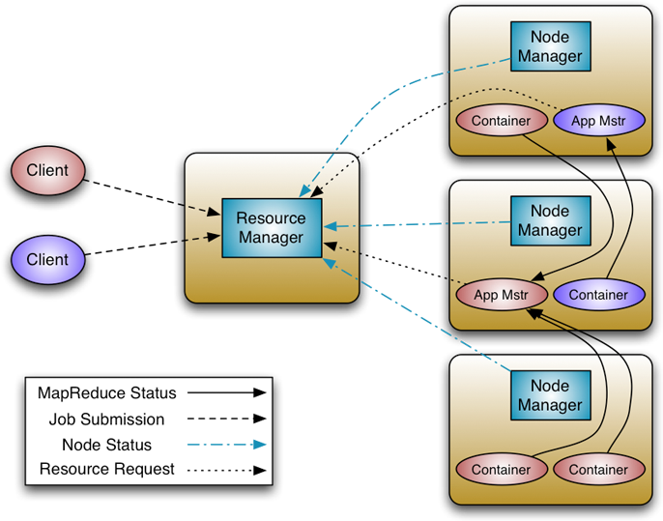
YARN
Resource Manager
Global resource scheduler
Hierarchical queues
Node Manager
Per-machine agent
Manages the life-cycle of container
Container resource monitoring
Application Master
Per-application
Manages application scheduling and task execution
E.g. MapReduce Application Master

Slide 70
Capacity Scheduler Configuration
ROOT
yarn.scheduler.capacity.root.capacity=100
yarn.scheduler.capacity.root.queues=adhoc,batch,prod
ADHOC
yarn.scheduler.capacity.root.adhoc.acl_submit_applications=*
yarn.scheduler.capacity.root.adhoc.capacity=25
yarn.scheduler.capacity.root.adhoc.maximum-capacity=50
yarn.scheduler.capacity.root.adhoc.state=RUNNING
yarn.scheduler.capacity.root.adhoc.user-limit-factor=2
PROD
yarn.scheduler.capacity.root.prod.acl_administer_queue=yarn
yarn.scheduler.capacity.root.prod.acl_submit_applications=yarn,mapred
yarn.scheduler.capacity.root.prod.capacity=50
yarn.scheduler.capacity.root.prod.queues=reports,ops
PROD - Reports
yarn.scheduler.capacity.root.prod.reports.state=RUNNING
yarn.scheduler.capacity.root.prod.reports.capacity=80
yarn.scheduler.capacity.root.prod.reports.maximum-capacity=100
yarn.scheduler.capacity.root.prod.reports.user-limit-factor=3
yarn.scheduler.capacity.root.prod.reports.minimum-user-limit-percent=20
yarn.scheduler.capacity.prod.reports.maximum-applications = 1

Slide 71
YARN Recent Features

Slide 72
YARN Timeline Server
Storage and retrieval of YARN application status information
Covers both current status and historical information
Addresses MapReduce v1 scalability bottleneck of storing job status information in JobTracker
Includes 2 kinds of status information
Generic
Application start/stop
Attempts
Container information
Application-specific
Varies depending on specific application running in YARN
MapReduce map tasks, reduce tasks, counters, etc.

Slide 73
Node Labels
What
Admin associates a label with a set of nodes (NodeManager).
1 node :: n labels AND 1 label :: n nodes
Admin allows (sets ACLs) for apps scheduled to a Capacity Scheduler Queue to schedule on labeled nodes
Admin can enforce (set Default) that all apps scheduled to a Queue be scheduled on label ‘A’ nodes
Why
Need a mechanism to enforce node-level isolation
Account for resource contention amongst non-YARN managed resources
Account for hardware or software constraints

Slide 74
CGroup Isolation
What
Admin enables CGroups for CPU Isolation for all YARN application workloads
Why
Applications need guaranteed access to CPU resources
To ensure SLAs, need to enforce CPU allocations given to an Application container

Slide 75
Summary
History of Hadoop
Scalable storage and compute infrastructure
Expanded to include a large ecosystem of related projects
HDFS: Hadoop Distributed File System
Scalable and fault tolerant distributed storage
Evolving to support new storage architectures
MapReduce
Parallel, distributed, scalable data processing
Computational model implemented in terms of a map function and a reduce function
YARN
Evolution of MapReduce infrastructure
Scalable execution of distributed applications on Hadoop cluster nodes
Backward-compatible with MapReduce v1, but also supports applications other than MapReduce

Slide 76
Thank you
Q&A

